Slide 1
Fundamentals, Prospectives and Challenges in Deep-learning based Voice Conversion
2024/8/14 CITI Talk
Wen-Chin Huang
Assistant professor, Graduate School of Informatics, Nagoya University

Slide 2
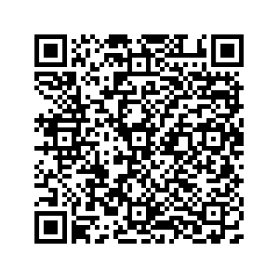
Link to today’s slides
2024/8/14 CITI Talk

Slide 3
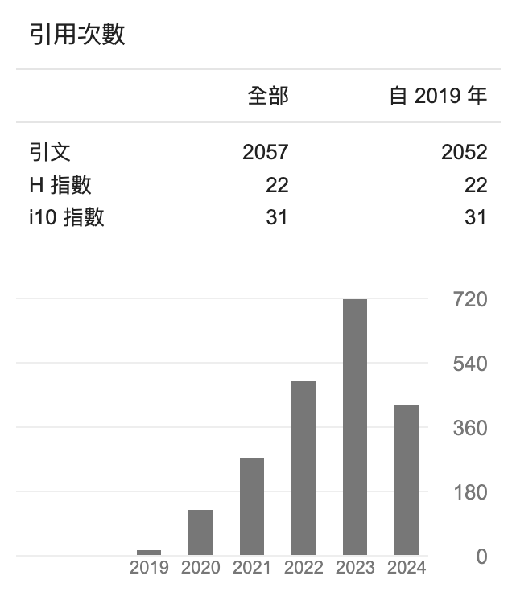
Self introduction
2024/8/14 CITI Talk
Name: Wen-Chin Huang
Education & Experience
2018.06 B.S., National Taiwan University, Taiwan
2017.07-2019.03 Research assistant, IIS, Academia Sinica 2020.07-2021.03
2021.03 M.S., Nagoya University, Japan
2021.08-2022.02 Research intern, Meta, USA 2022.05-2022.09
2023.04-2024.03 Student Researcher, Google DeepMind Japan
2024.03 Ph.D., Nagoya University, Japan
2024.04- Assistant professor, Nagoya University, Japan
Research interest： Speech synthesis/conversion/evaluation
(as of 2024/8/13)

Slide 4
Outline
2024/8/14 CITI Talk
Fundamentals of voice conversion
What is voice conversion? Why do we need it?
Early approaches to voice conversion
How deep learning changed voice conversion
Better modeling tools
Better content & speaker representations
Challenges remaining in voice conversion
Real-time, low-latency processing
Beyond “normal” voice conversion

Slide 5
Outline
2024/8/14 CITI Talk
Fundamentals of voice conversion
What is voice conversion? Why do we need it?
Early approaches to voice conversion
How deep learning changed voice conversion
Better modeling tools
Better content & speaker representations
Challenges remaining in voice conversion
Real-time, low-latency processing
Beyond “normal” voice conversion

Slide 6
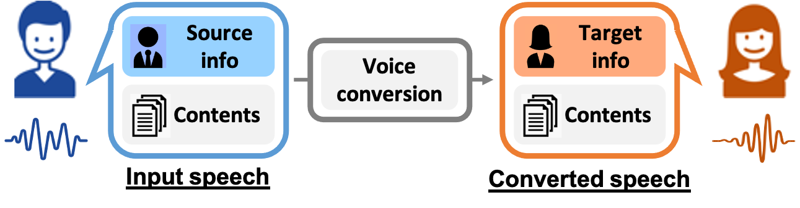

What is voice conversion (VC)?
What is voice conversion (VC)? Why do we need it?
Definition: Converts one kind of speech to another while keeping the linguistic content.
The most common type: speaker conversion
Convert between two speakers
Famous example (in Japan): Detective Conan
“VC” basically refers to “speaker conversion” if not specified

Slide 7
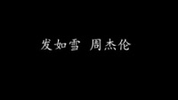


VC can be dangerous: deep fake (singer copying)
Fundamentals of voice conversion
Original song
From Taiwanese singer Jay Chou
Classical song from Singapore singer Stefanie Sun
Copied song
The singer did not know her voice was being copied!

Slide 8
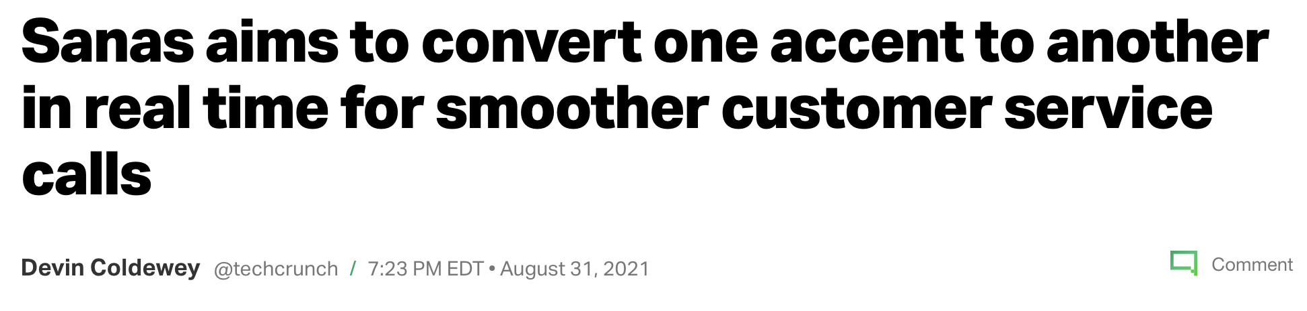
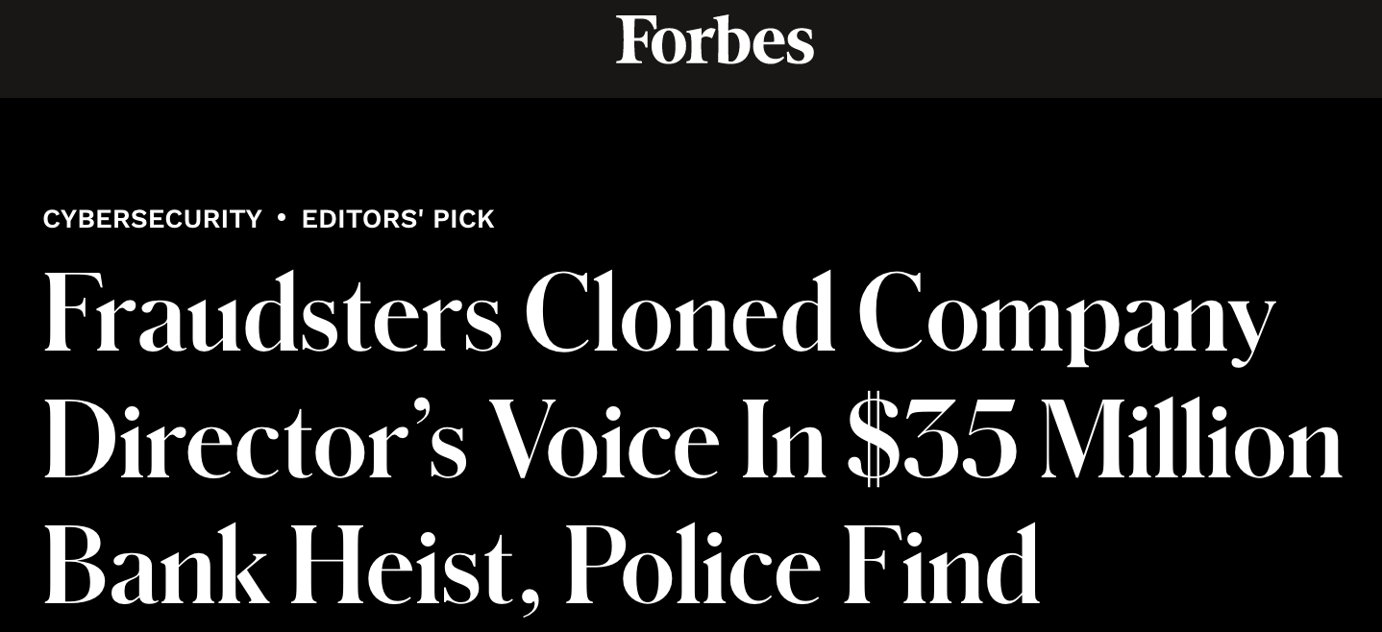
VC can be dangerous: fraud
Fundamentals of voice conversion
https://techcrunch.com/2021/08/31/sanas-aims-to-convert-one-accent-to-another-in-real-time-for-smoother-customer-service-calls/
https://www.forbes.com/sites/thomasbrewster/2021/10/14/huge-bank-fraud-uses-deep-fake-voice-tech-to-steal-millions/?sh=3eb9bf375591
It should be used in a good way!

Slide 9
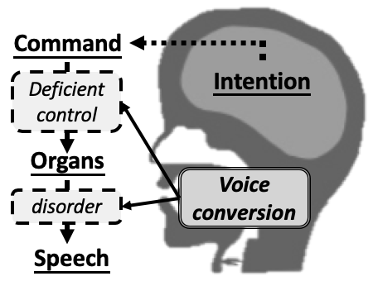
So why do we need VC? – An ultimate goal
Fundamentals of voice conversion
[Toda ‘14]
Augmented Communication
Physical condition of the human body limits the production of speech.
VC can be used to break the barrier.
Ex 1. Deficient control of the organs
Result: accented voice
Ex 2. Damaged speech organs
Result: severe vocal disorders

Slide 10




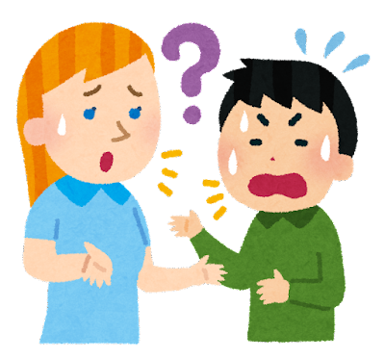



We can think of a lot of applications…
Fundamentals of voice conversion
I cannot sing!
→ Singing voice conversion
Application: autotune,Vtuber, etc.
I cannot speak good Japanese!
→ Accent conversion
Application: customer service; language learning
Let’s start by asking ourselves: what can’t I do?
I cannot speak! (maybe in the future)
→ Electrolarygeal VC
Application: speaking-aid

Slide 11
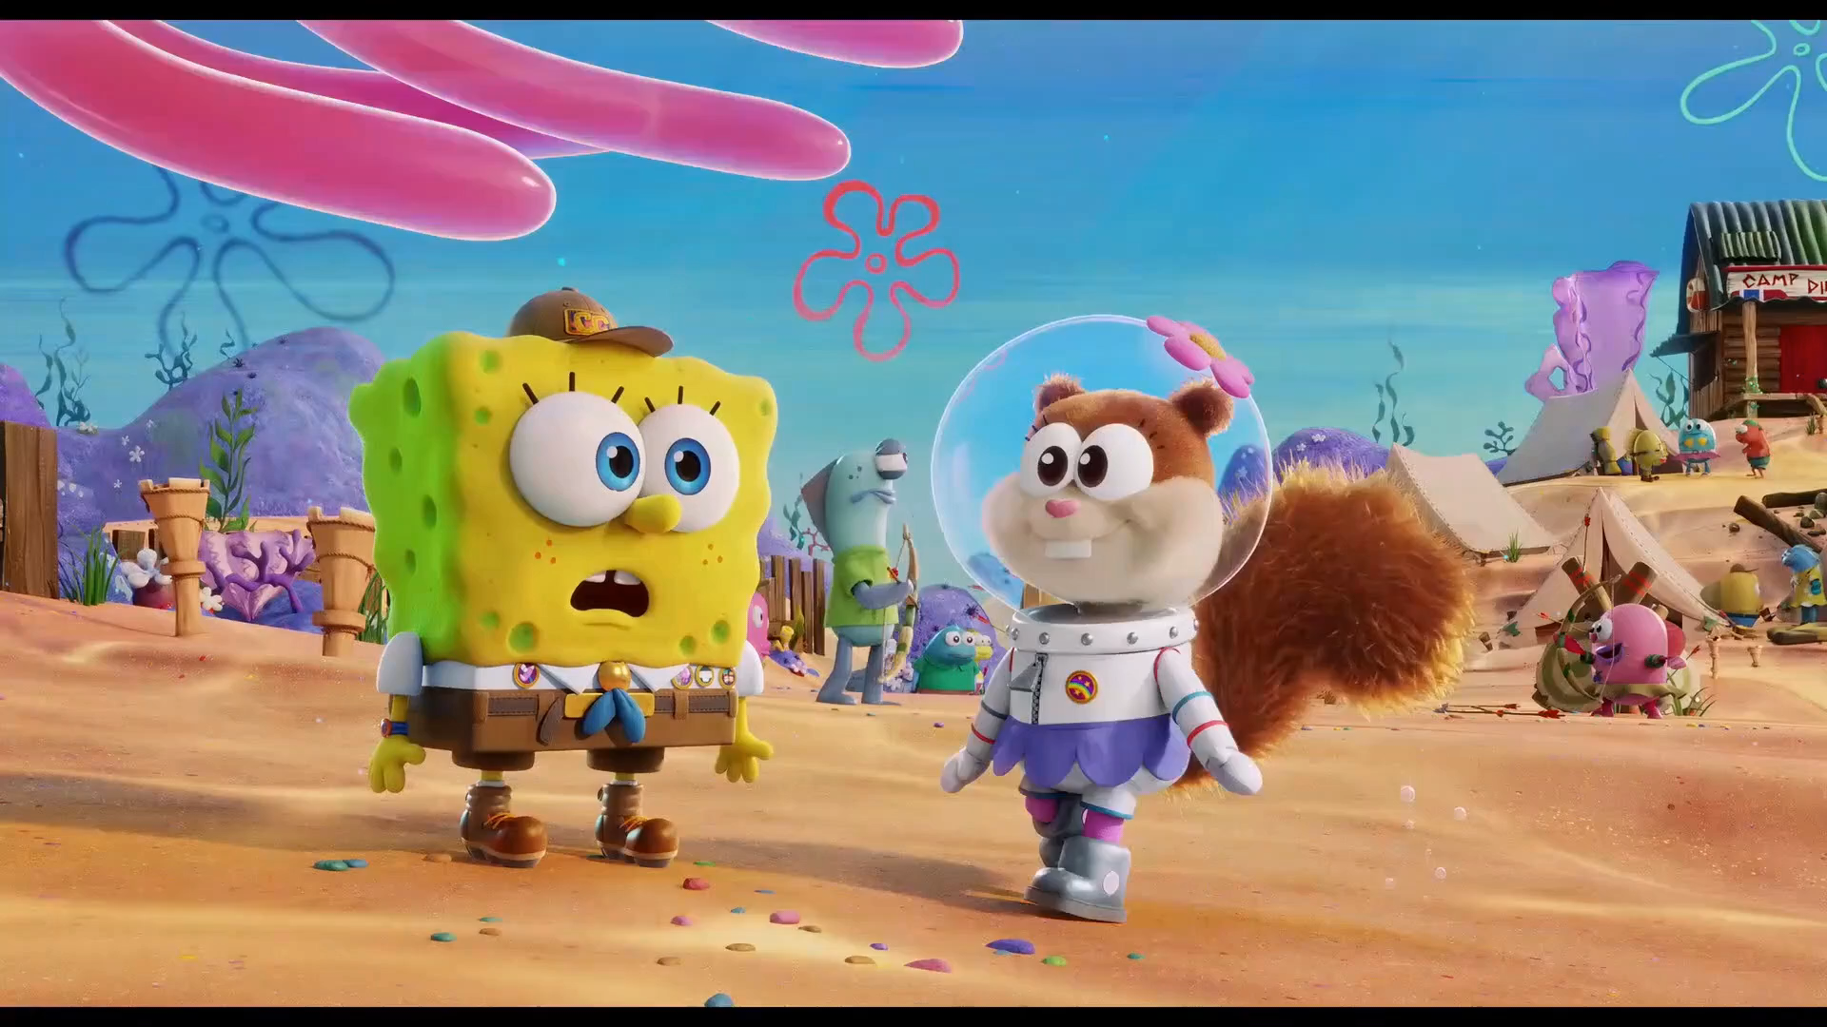

Interesting application that I really like: dubbing
Fundamentals of voice conversion
[Gan+ ‘22]
Original
Converted
https://wblgers.github.io/IQDUBBING-VC.github.io/

Slide 12
Outline
2024/8/14 CITI Talk
Fundamentals of voice conversion
What is voice conversion? Why do we need it?
Early approaches to voice conversion
How deep learning changed the voice conversion
Better modeling tools
Better content & speaker representations
Challenges remaining in voice conversion
Real-time, low-latency processing
Beyond “normal” voice conversion

Slide 13
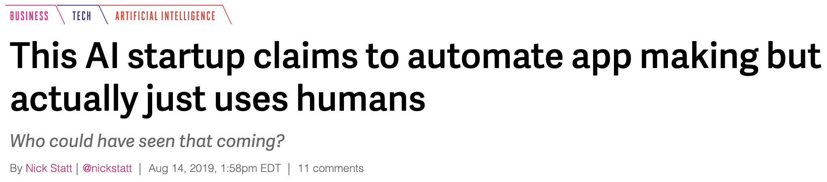
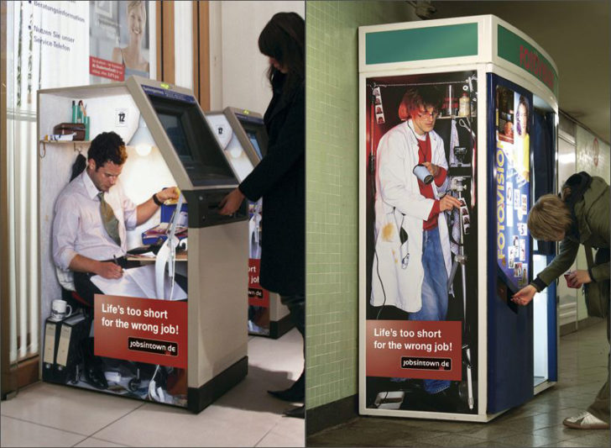
What would you do if YOU were asked to perform VC?
Fundamentals of voice conversion
https://www.theverge.com/2019/8/14/20805676/engineer-ai-artificial-intelligence-startup-app-development-outsourcing-humans
Arturo de Albornoz@Flickr

Slide 14


Parallel VC: how people did VC research 30 years ago
Fundamentals of voice conversion
[Abe+ ‘90] [Stylianou+ ‘98]
Idea: collect a parallel corpus, and find a mapping function
たったひとつの真実見抜く
たったひとつの真実見抜く
見た目は子ども、頭脳は大人
見た目は子ども、頭脳は大人
その名は名探偵コナン！
Collect utterances with same contents by the source & target speaker
その名は名探偵コナン！

Slide 15



Parallel VC: how people did VC research 30 years ago
Fundamentals of voice conversion
[Abe+ ‘90] [Stylianou+ ‘98]
Idea: collect a parallel corpus, and find a mapping function
たったひとつの真実見抜く
たったひとつの真実見抜く
Note: the model does not necessary know the “words” in the utterance
“た”
“た”

Slide 16
On the size of a parallel dataset
Fundamentals of voice conversion
Think about it: How much data are you willing to record?
Experimentally, (I think) we need at least one hour of parallel data
In practice, 5 minutes is considered “okay”
But many people will not be willing to record even 5 minutes of data!

Slide 17
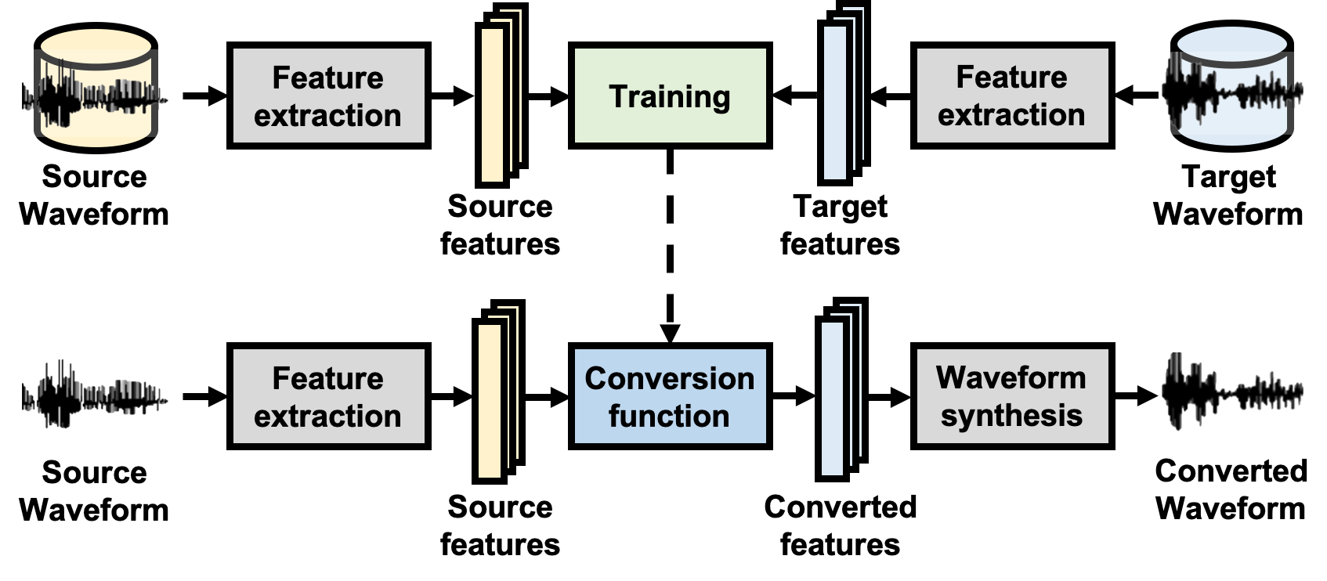
Parallel VC: how people did VC research 30 years ago
Fundamentals of voice conversion
[Abe+ ‘90] [Stylianou+ ‘98]
In practice, a typical VC system has three components
Feature extraction, conversion, waveform synthesis (all are important!)
usually this is a machine learning model

Slide 18
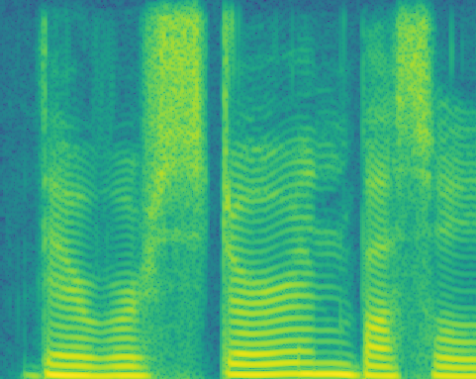

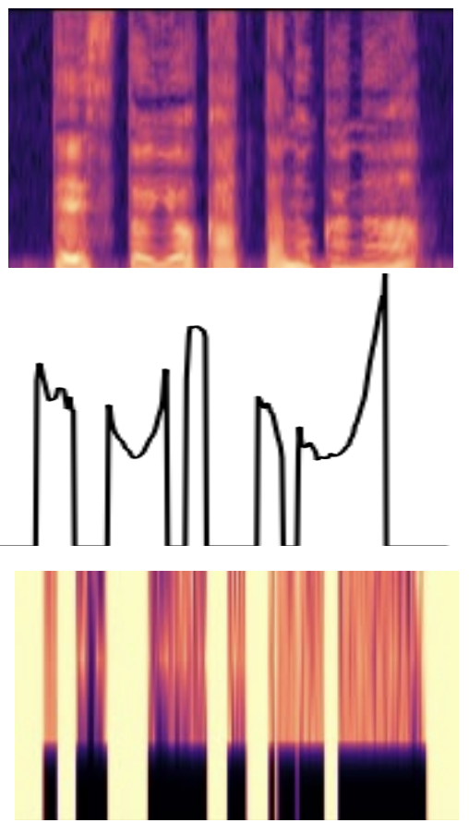
Speech processing 101: features
Fundamentals of voice conversion
Speech is a kind of waveform = super dense 1-D data
Telephone speech: 8000 Hz = 8000 samples per second
Singing voice (or music): 44100 Hz = 44100 samples per second!
Super complicated, too difficult for machine learning models!
It is easier to model in the frequency domain
Time-frequency representation
Spectrogram
Mel spectrogram (= spectrogram → mel filter bank)
Short time Fourier Transform (STFT)
Vocoder parameters
Spectral envelope
Fundamental frequency (f₀)
Aperiodicity signal
Speech waveform
Vocoder (ex. source-filter model)

Slide 19
Parallel VC: how people did VC research 30 years ago
Fundamentals of voice conversion
[Abe+ ‘90] [Stylianou+ ‘98]
An important question: time alignment
Source and target utterances can be of different lengths.
To calculate loss, we need to align the features.
Same length
Source speech
1
2
3
4
5
6
1
2
3
4
5
6
How are you
The conversion function can be any machine learning model. Traditional choice: Gaussian mixture models (GMMs)
Time alignment obtained by DTW
Conversion function
Target speech
1
2
3
4
1
1
2
3
3
4
How are you
It’s not difficult to see that this is a frame-based mapping = output length is always same as input ☹
Because the source and target utterances are parallel, two mapped features are likely to have the same content!
Same length

Slide 20
Categorize VC based on “what speaker can be handled”
Fundamentals of voice conversion
One-to-one VC
Can convert one training source speaker to one training target speaker
Traditional parallel VC falls in this category
Many-to-one VC
Can convert multiple training source speakers to one training target speaker
Any-to-one VC
Can convert any unseen source speaker to one training target speaker
Can you guess what one-to-many VC means?
This categorization is based on the data used in model learning

Slide 21
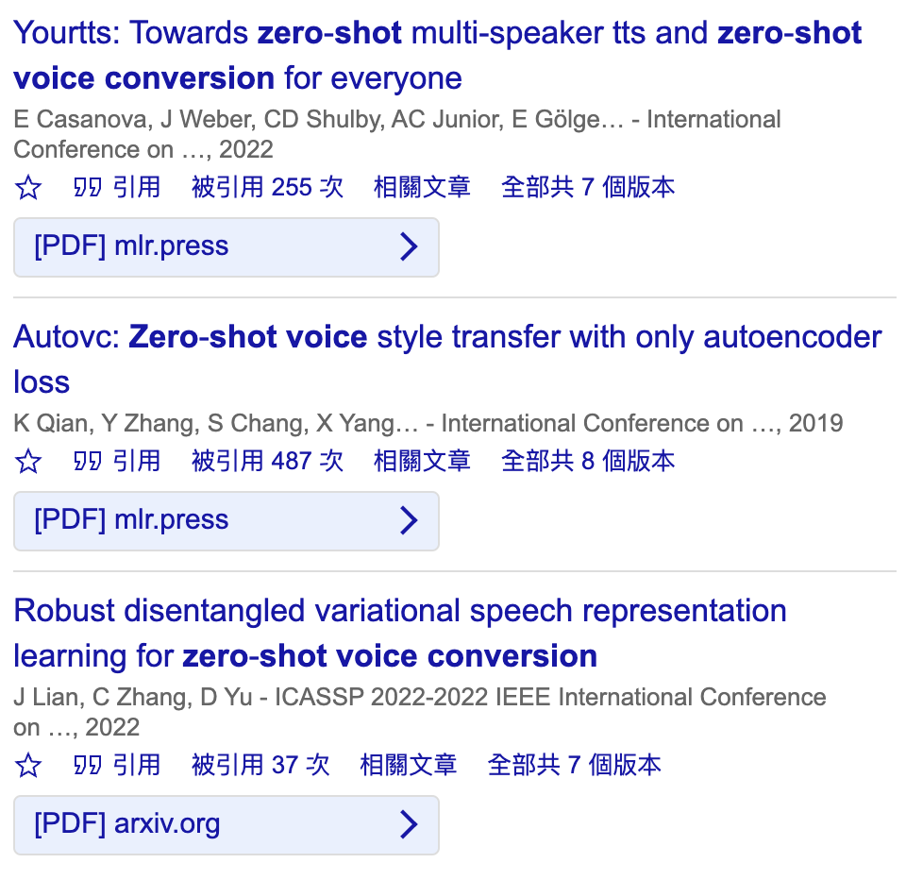

Ultimate goal: any-to-any VC
Fundamentals of voice conversion
Also known as one-shot VC
Can convert to any unseen speaker with only one utterance
Ex. Conan wants to copy Hattori’s voice now
But it is difficult to collect a lot of his data…
Any-to-any VC is easy for human, but not for machine!
By listening to one speech clip, human can easily imagine how this person talks!
Human is smart, but machine is not…
There are many papers use the term “zero-shot VC”. Is the term ”zero-shot” proper?
たったひとつの真実見抜く

Slide 22
Evaluation in VC (and speech synthesis in general)
Fundamentals of voice conversion
Subjective evaluation (human judgement) is considered the golden standard to evaluate machine-generated speech
Because it is human who will be listening to these speech samples
Objective evaluation metrics are just for reference
Ex., mean square error of generated speech and ground truth speech
They are considered to be not aligned well with human judgements. ⇨ A > B in objective metric does not always mean A > B by human.
Usually done through a mean opinion score (MOS) test
Listen to sample ⇨ choose a rating (usually 1-5)
[Wagner+ ‘19]

Slide 23
Aspects to evaluate in VC
Fundamentals of voice conversion
Naturalness := how natural the generated sample sounds
There is a tendency to use “naturalness” over “quality”, which is vague.
Naturalness is a “basic aspect” shared by all speech synthesis tasks
In speaker conversion, conversion similarity is also important
How to evaluate? a common approach:
Let the listener listen to (1) converted sample (2) reference sample
(1) and (2) can be of the same contents (some people choose different contents)
Ask the listener “do you think these two samples are spoken by the same person?”
The listener does not know which one is the reference
If (1) and (2) are of the same contents, does it make it easier to think they come from the same speaker?

Slide 24
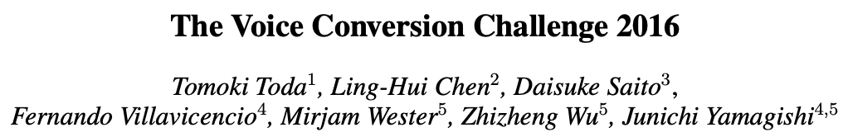
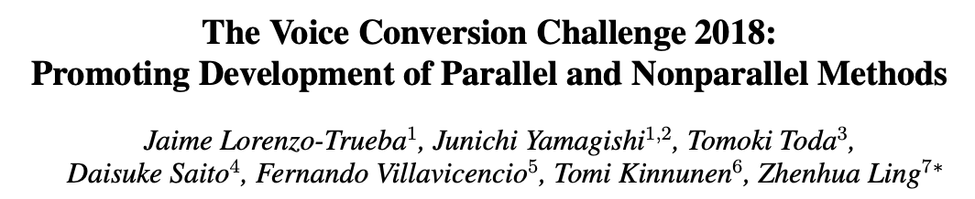
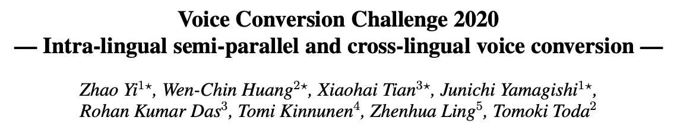
The voice conversion challenge (VCC) series
Fundamentals of voice conversion
http://www.vc-challenge.org/
Bi-annual scientific event for VC since 2016
Goal: to provide
Common datasets for fair comparisons
Baselines as starter kits
Insights & future research directions
 | Task 1 (easy) | Task 2 (hard)
VCC ‘16 | Parallel VC
VCC ’18 | Parallel VC | Nonparallel VC
VCC ’20 | Intra-lingual VC | Cross-lingual VC

Slide 25
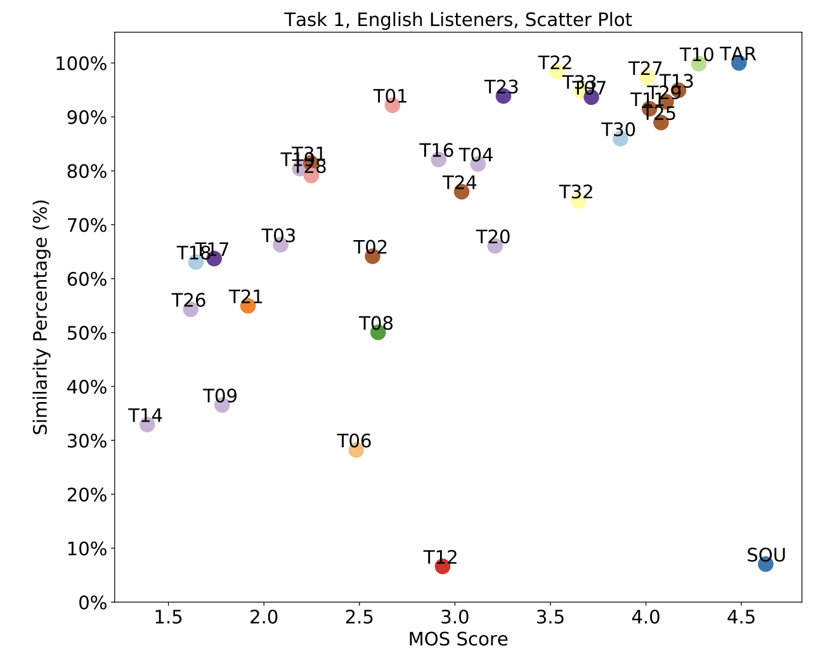
Normal VC seems to be “solved”
Fundamentals of voice conversion
[Yi+ ‘20]
Setting: English-to-English, ~5 mins of training data
Results from VCC’20
Human-level naturalness & similarity
(Technically: no statistical difference with natural speech)
Deep learning has contributed a lot!

Slide 26
Outline
2024/8/14 CITI Talk
Fundamentals of voice conversion
What is voice conversion? Why do we need it?
Early approaches to voice conversion
How deep learning changed voice conversion
Better modeling tools
Better content & speaker representations
Challenges remaining in voice conversion
Real-time, low-latency processing
Beyond “normal” voice conversion

Slide 27
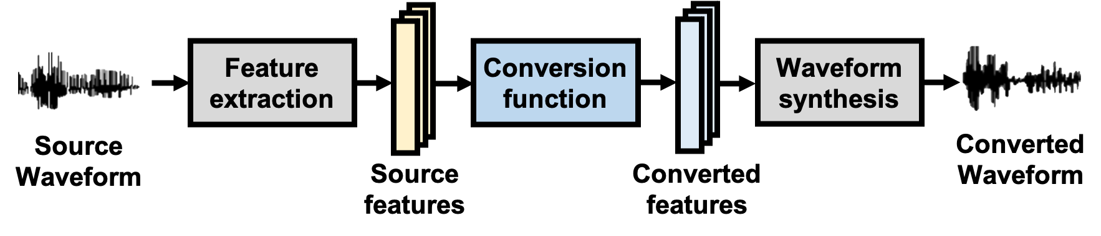
Flaws in a traditional parallel VC system
How deep learning changed voice conversion
source
target
converted
Poor prosody modeling due to frame-based structure
Model does not convert the length
Poor audio quality due to insufficient modeling power
Traditional ML models like GMMs are not descriptive enough
Traditional vocoders pose too many constraints, hurting quality
Inflexible training and conversion due to parallel training
The cost of collecting parallel datasets is high
Restricted to one-to-one VC ⇨ cannot handle unseen speakers

Slide 28
Outline
2024/8/14 CITI Talk
Fundamentals of voice conversion
What is voice conversion? Why do we need it?
Early approaches to voice conversion
How deep learning changed voice conversion
Better modeling tools
Better content & speaker representations
Challenges remaining in voice conversion
Real-time, low-latency processing
Beyond “normal” voice conversion

Slide 29
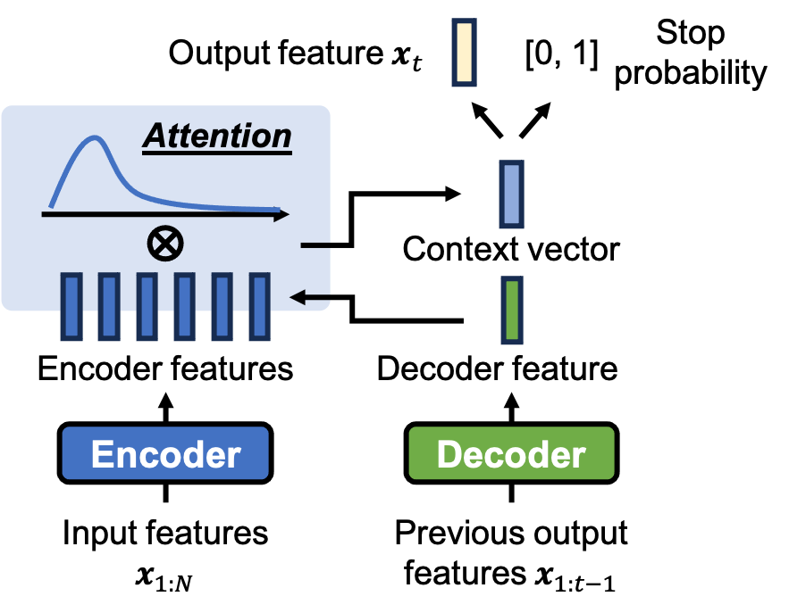
Sequence-to-sequence (seq2seq) modeling
How deep learning changed voice conversion: better modeling tools
[Tanaka+ ‘19] [Huang+ ‘20]
Autoregressive (AR) seq2seq VC w/ RNNs or Transformers
☺ can model duration = can model prosody
Accent, speaking rate, etc. are important factors to conversion similarity
source
target
converted
Two flaws
AR modeling is fragile (ex., hallucination in NLP)
Very data hungry, typically needs > 1 hr of data
(can be thought of as the reason of flaw 1)

Slide 30
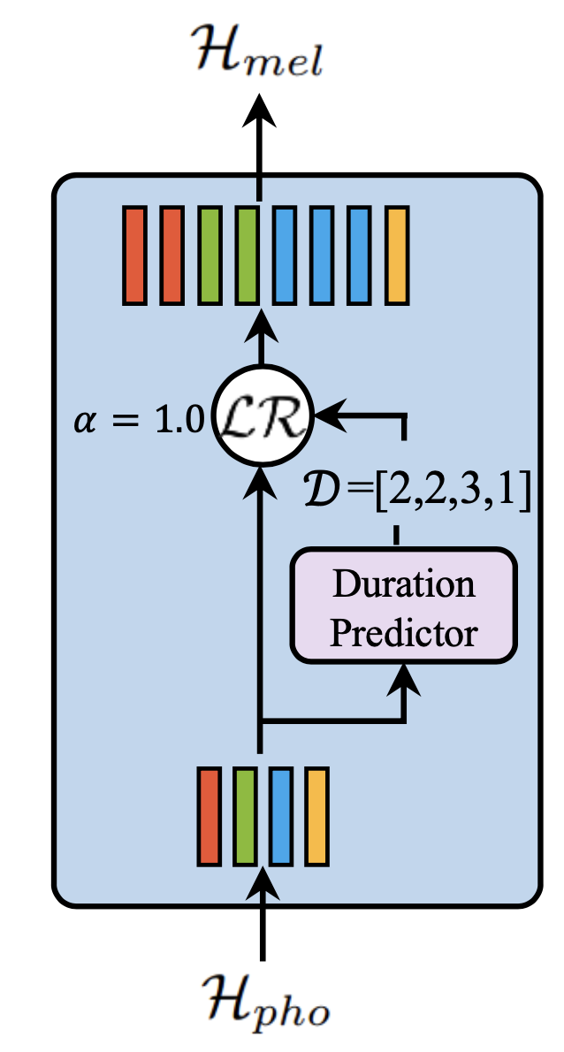
Non-autoregressive seq2seq modeling
How deep learning changed voice conversion: better modeling tools
AR seq2seq modeling is hard because the model tries to do two things at the same time
Duration modeling
Acoustic modeling
Non-AR seq2seq: decouple duration modeling
A duration predictor generates the length of each input frame
Representative model: FastSpeech 1 & 2 (FS1 & FS2)
The duration predictor is trained w/ MSE loss w.r.t. ground truth duration from a teacher model
In TTS: from an AR model or a forced aligner
This line of research problem is shared between TTS and VC
[Ren+ ‘20]

Slide 31
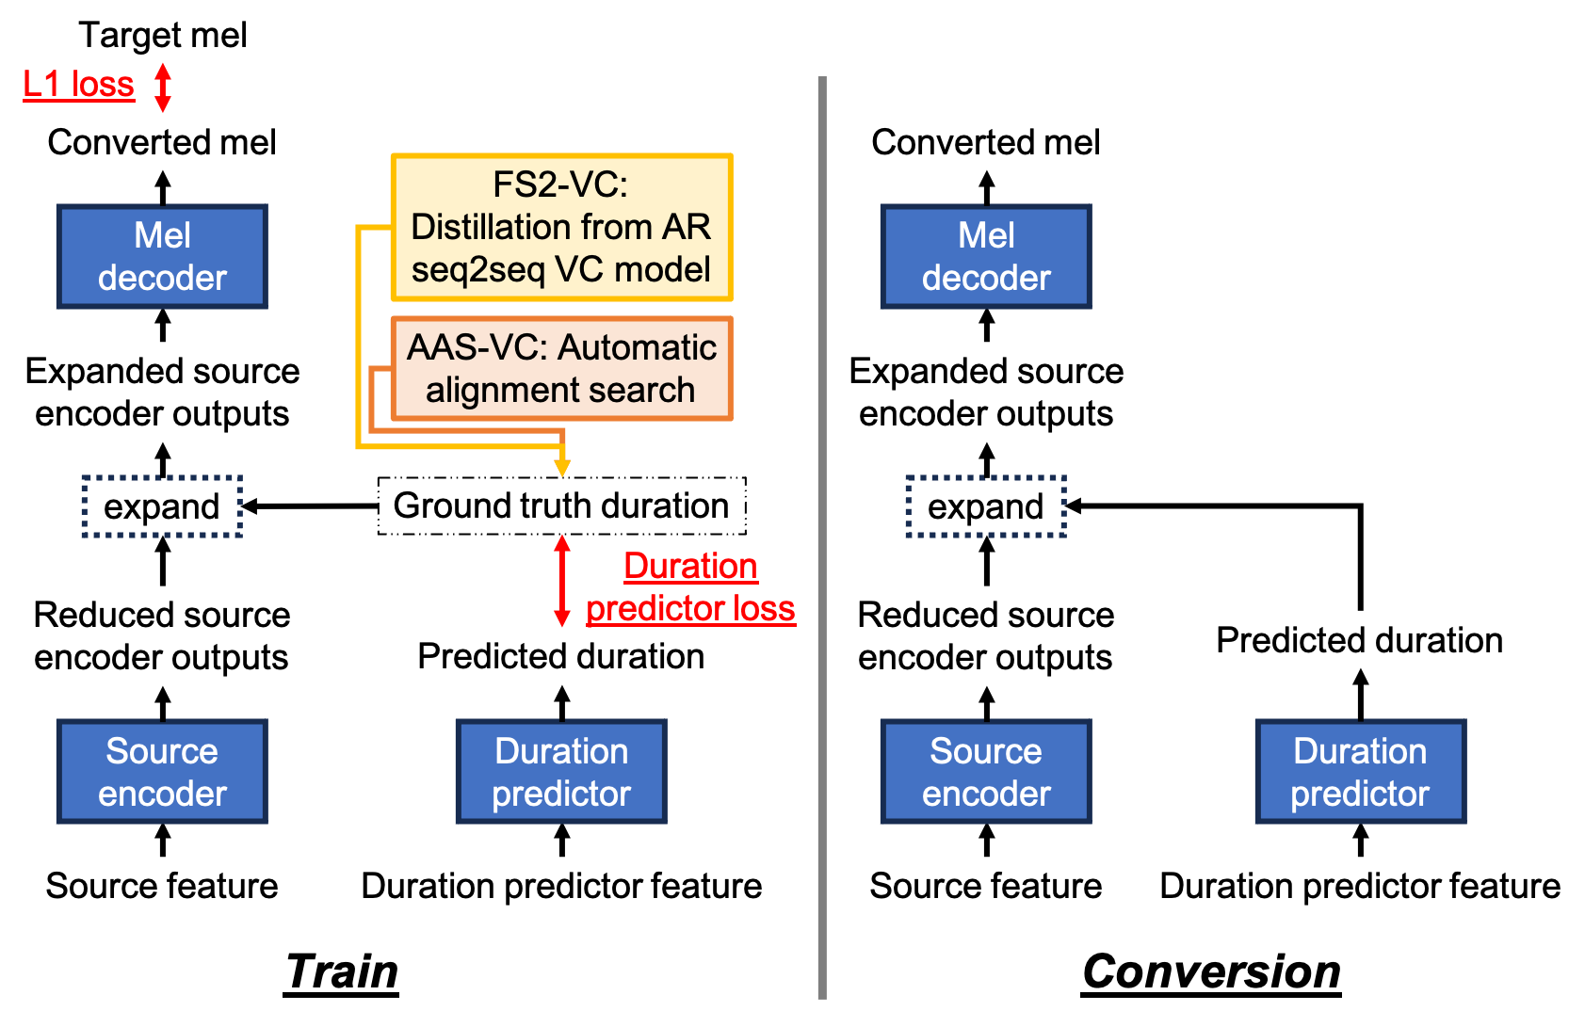
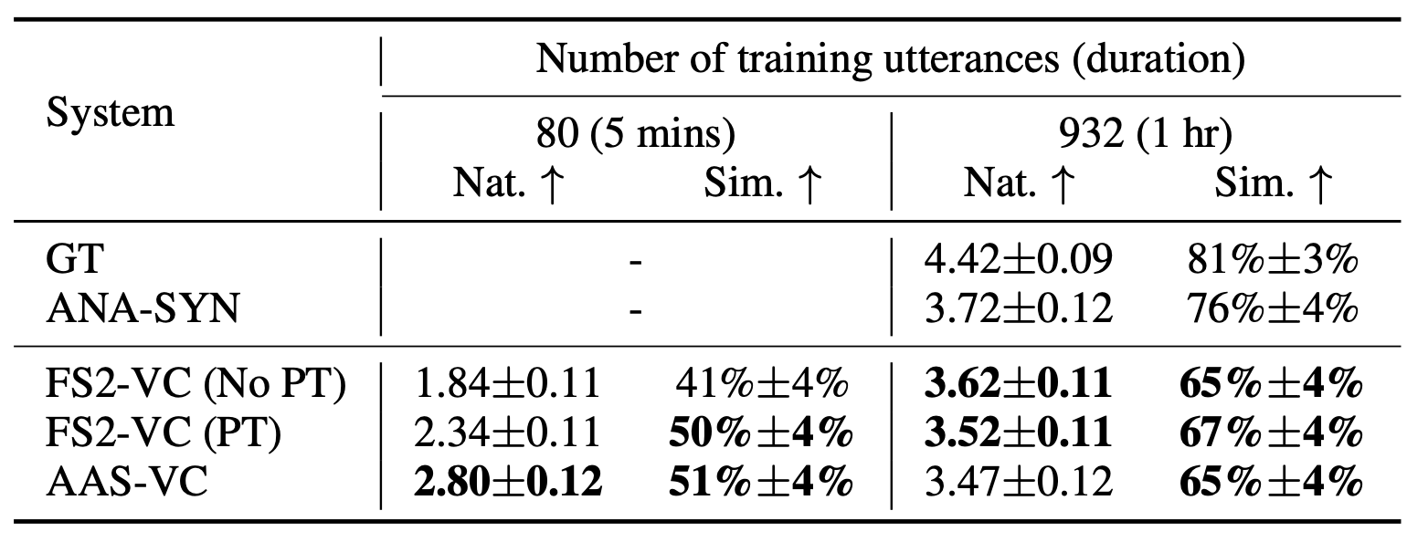
Non-autoregressive seq2seq VC
How deep learning changed voice conversion: better modeling tools
[Hayashi+ ‘21] [Huang+ ‘23]
Can we avoid using a teacher model? Yes
Methods like monotonic alignment search (MAS) were proposed
Which is better?
Depends on the data at hand!
[Kim+ ‘21]

Slide 32
In pursue of greater modeling power
How deep learning changed voice conversion: better modeling tools
VC is a subfield of speech generative modeling
Generative modeling = learn (approximate) the distribution of the data
The better the model captures the distribution, the better the quality
(As mentioned before) speech is super difficult to model
We always need better modeling techniques
These techniques are used in these two parts:

Slide 33

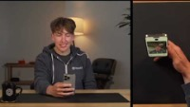
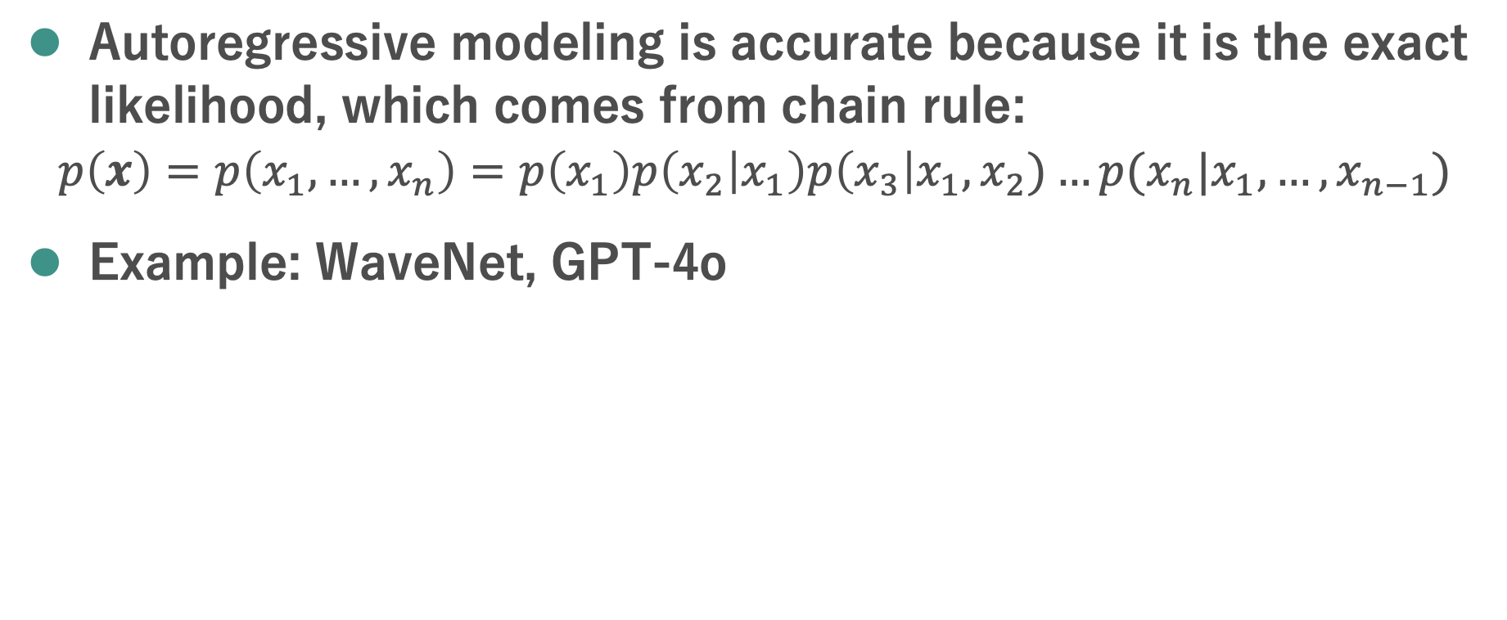
Technique 1: autoregressive modeling
How deep learning changed voice conversion: better modeling tools
Autoregressive modeling is accurate because it is the exact likelihood, which comes from chain rule:
$$p\left(x\right)=p\left(x_{1},…,x_{n}\right)=p\left(x_{1}\right)p\left(x_{2} | x_{1}\right)p\left(x_{3}\right|x_{1},x_{2})…p(x_{n}|x_{1},…,x_{n−1})$$
Example: WaveNet, GPT-4o
[van den Oord+ ‘16]
Disadvantage: slow

Slide 34
Technique 2: generative adversarial net (GAN)
How deep learning changed voice conversion: better modeling tools
[Goodfellow+ ‘14]
Discriminator: try to distinguish real and fake Generator: try to fool the discriminator
In fact there is a very rigorous mathematical formulation behind GAN…
I recommend reading this tutorial:
GAN used to be famous for “hard to train”
Difficult to set the hyper-parameters
But now it has become very simple thanks to researchers’ efforts!
Famous “GAN in VC” papers:
https://speech.ee.ntu.edu.tw/~tlkagk/courses/MLDS_2018/Lecture/GANtheory%20(v2).pdf
[Hsu+ ‘17] [Chou+ ‘18] [Kaneko+ ‘18]
Disadvantage: the formulation of GAN is an “approximation”

Slide 35
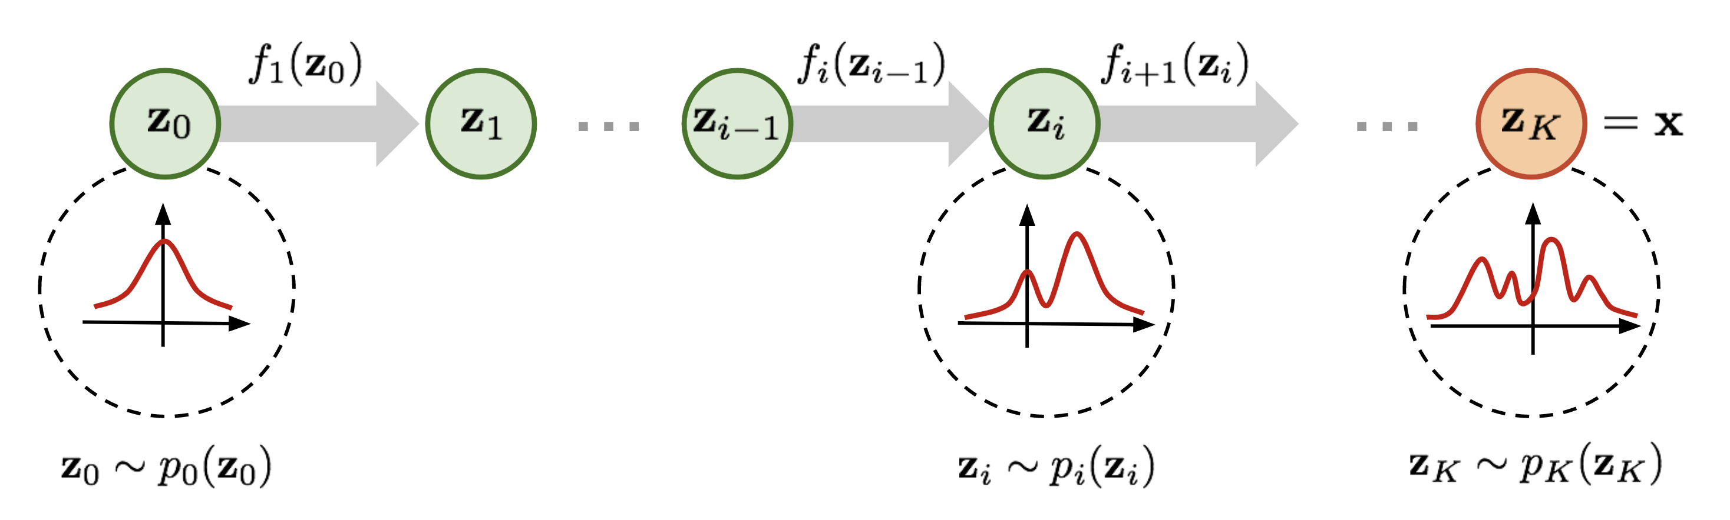
Technique 3: normalizing flow
How deep learning changed voice conversion: better modeling tools
[Dinh+ ‘14]
Transforms a simple distribution into a complex one by applying a sequence of invertible transformation functions.
There is also a rigorous math formulation…
Recommended tutorial: https://blog.evjang.com/2018/01/nf1.html
Advantage: exact likelihood, and it’s faster than auto-regressive modeling
Famous “flow in speech synthesis” papers:
Figure from https://lilianweng.github.io/posts/2018-10-13-flow-models/
[Pregnar+ ‘19][Kong+ ‘21]
Disadvantage: requires a large model, difficult to train

Slide 36
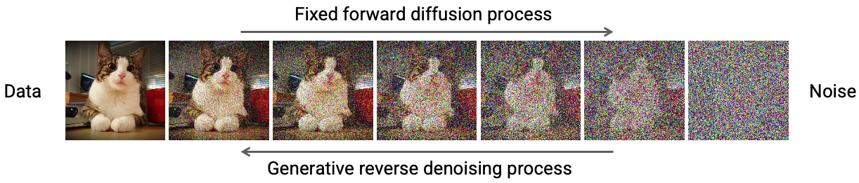
Technique 4: diffusion modeling
How deep learning changed voice conversion: better modeling tools
[Ho+ ‘20][Yang+ ‘21]
Transform from noise to data (similar to flow!)
More math… even thermodynamics…
Advantages: better quality than GAN, easier to train than flow
Famous “diffusion in speech synthesis” papers:
https://deeplearning.cs.cmu.edu/F23/document/slides/lec23.diffusion.updated.pdf
[Liu+ ‘22] [Ju+ ‘24]
Disadvantage: the number of diffusion steps makes generation slow

Slide 37
Outline
2024/8/14 CITI Talk
Fundamentals of voice conversion
What is voice conversion? Why do we need it?
Early approaches to voice conversion
How deep learning changed voice conversion
Better modeling tools
Better content & speaker representations
Challenges remaining in voice conversion
Real-time, low-latency processing
Beyond “normal” voice conversion

Slide 38
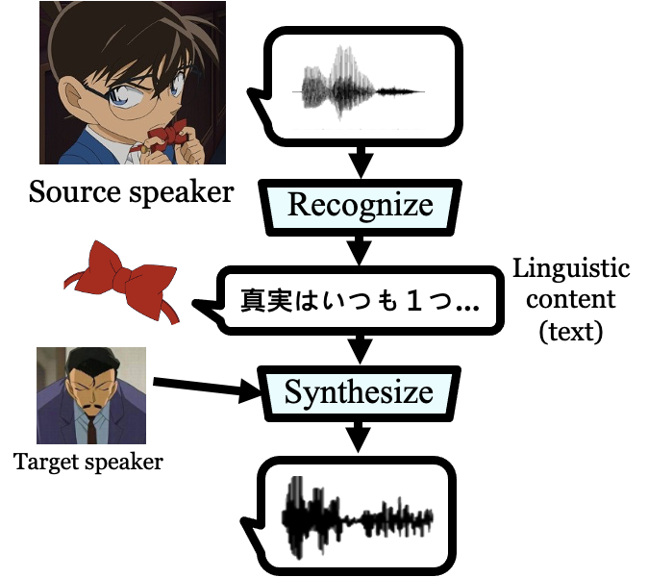
Let’s think again: what would you do if YOU were asked to perform VC?
How deep learning changed voice conversion: better content & speaker representations

Slide 39
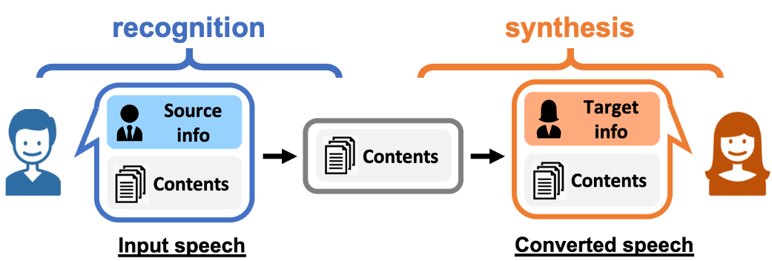
This is called “recognition-synthesis” VC
How deep learning changed voice conversion: better content & speaker representations
Recognition = (1) extract “desired” information (2) eliminate “unwanted” source information
Ex., in speaker conversion, extract contents, eliminate speaker info
Synthesis = Inject condition (target) information

Slide 40
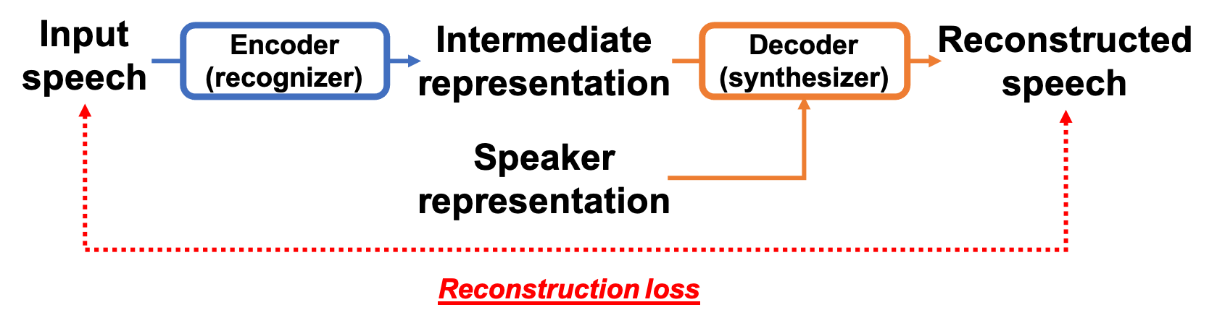
Two ways to categorize recognition-synthesis VC
How deep learning changed voice conversion: better content & speaker representations
First category: joint training of the recognizer & synthesizer
Also called “auto-encoder” based VC
During training, the model tries to reconstruct the input speech.
Don’t need parallel datasets anymore!
The point is to design a good information bottleneck.
Ex., variational autoencoder (VAE), vector quantization (VQ), …
Parallel VC ↔ Nonparallel VC

Slide 41
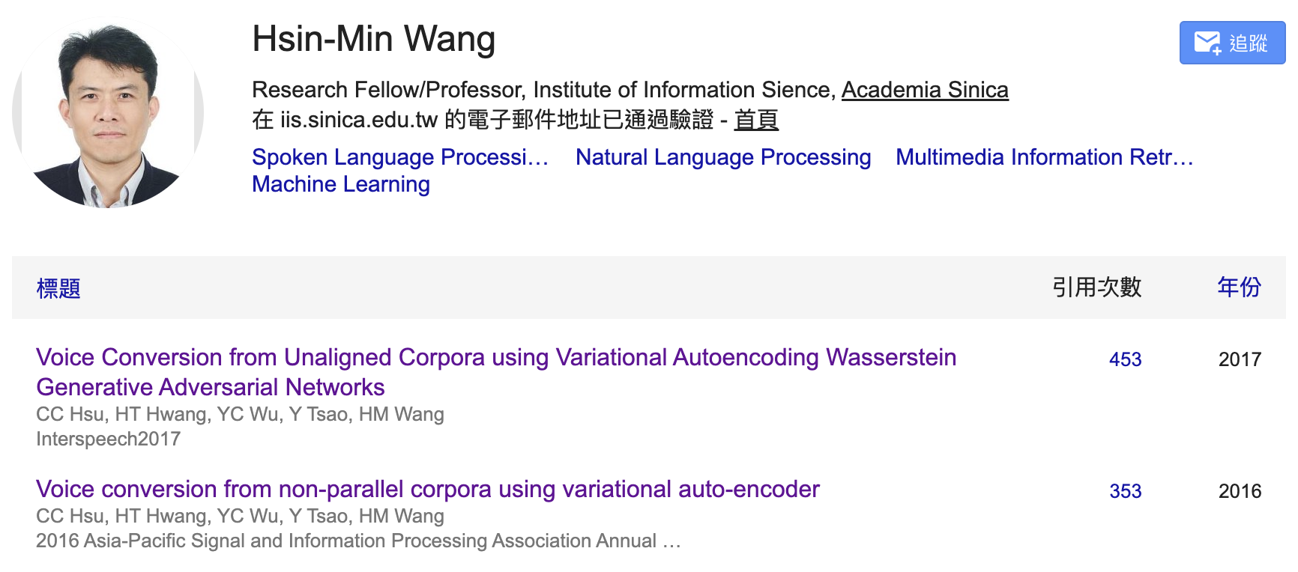
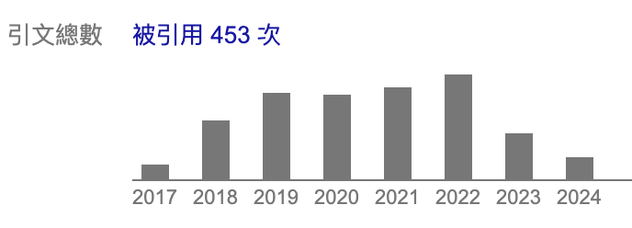
Autoencoder-based VC was HOT in 2018-2022
How deep learning changed voice conversion: better content & speaker representations

Slide 42
Two ways to categorize recognition-synthesis VC
How deep learning changed voice conversion: better content & speaker representations
Second category: separate training
Train the recognizer to extract the desired information
Train the synthesizer to generate desired speech with condition
Similar to auto-encoder based VC -- don’t need parallel datasets!
Straightforward example: cascade ASR+TTS
Directly use pre-trained automatic speech recognition and text-to-speech models
Problem: error propagation
[Huang+ ‘20]
source
target
converted
Ground truth: In reality the European Parliament is practising delay tactics.
Recognized: In reality the European parliament is practising dialectics

Slide 43
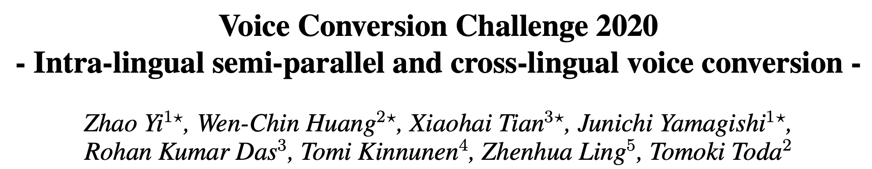
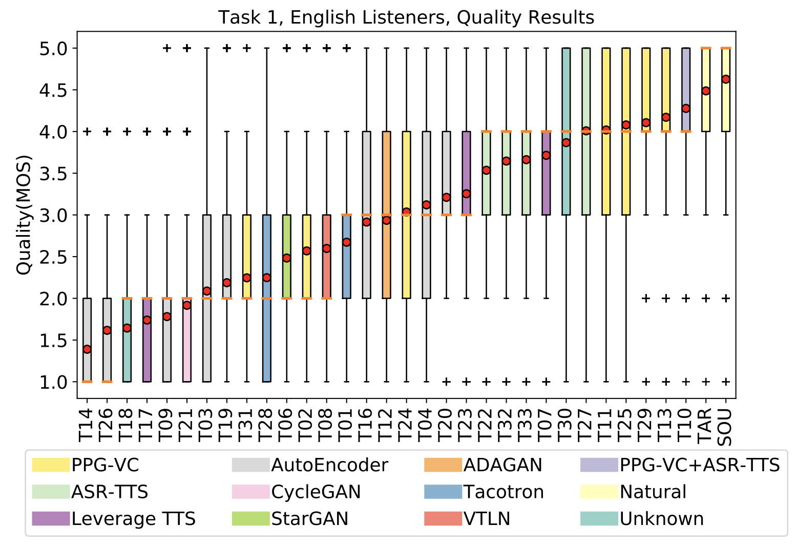
Auto-encoder based VC was outperformed
How deep learning changed voice conversion: better content & speaker representations
[Zhao+ ‘20]
The best auto-encoder ranked 13th in 2020 ☹
Separate training has thus become the mainstream

Slide 44
Content representation is important
How deep learning changed voice conversion: better content & speaker representations
Why does error propagation happen? Ans: the recognizer throws away too much information
 | Speech waveform | Spectrogram | SSL features | PPG (ASR encoder outputs) | Text
Resolution | 16000 Hz | 160~320 Hz | 160~320 Hz | 160~320 Hz | 1~2 Hz (1~2 words per second)
Speaker information | Complete | Complete | Much ~ few | Almost none | Almost none
Can we find some features in the middle?

Slide 45
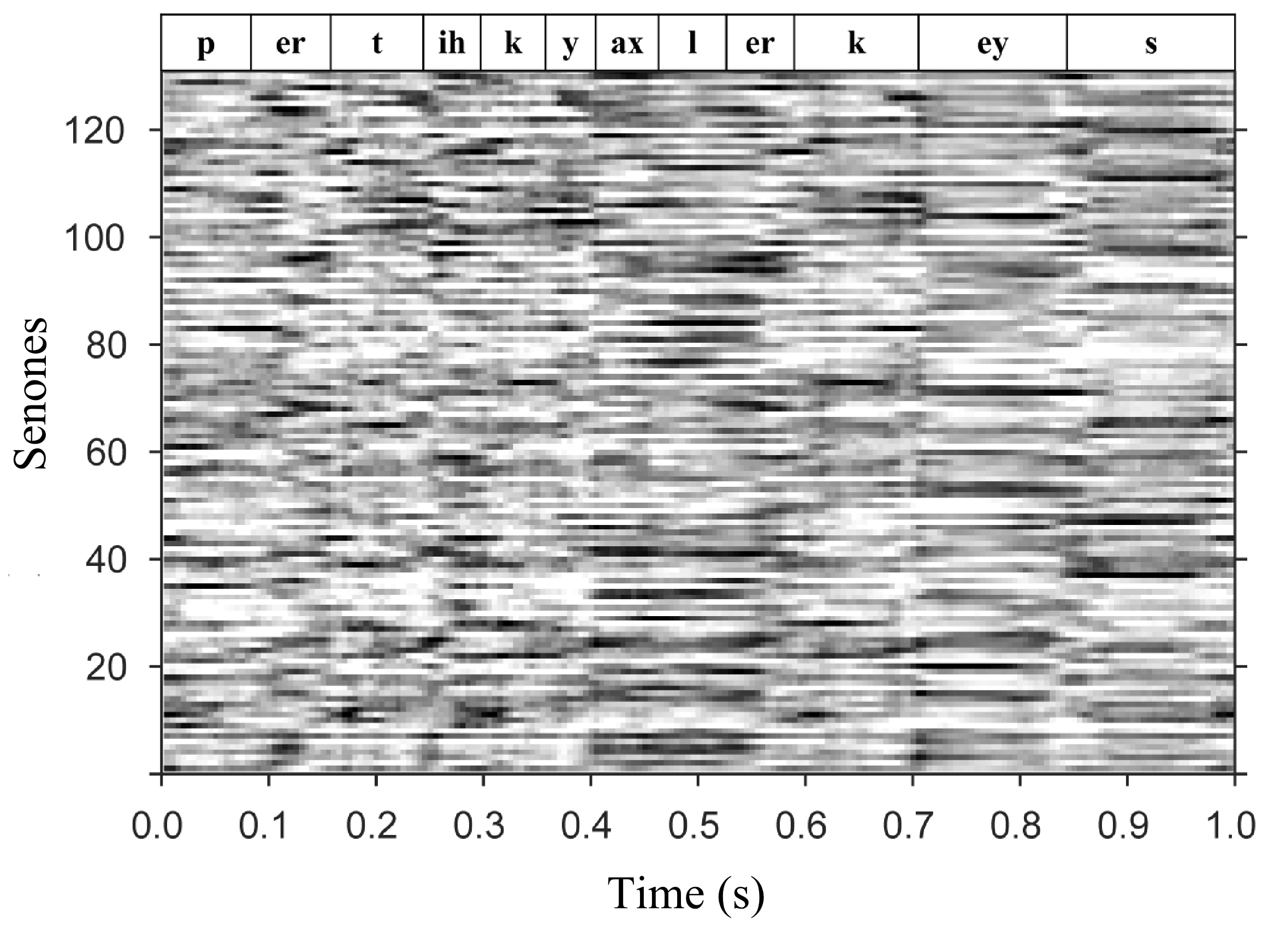
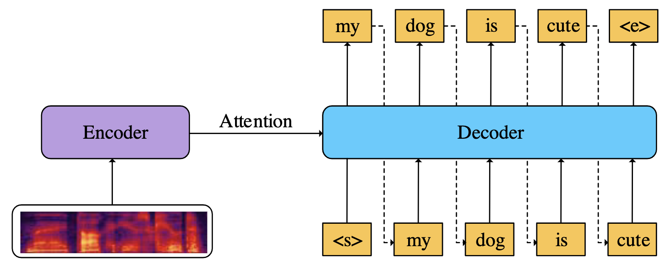
Phonetic posteriorgram (PPG)/ ASR encoder outputs
How deep learning changed voice conversion: better content & speaker representations
[Sun+ ‘16] [Liu+ ‘21]
What is PPG?
A time-class matrix of the posterior probabilities of each phonetic class for each specific time frame.
→ A frame-based pure content representation
PPG is a natural by-product of traditional ASR (= difficult to collect nowadays)
Alternative: ASR encoder outputs
Also contains pure content information
Ex. Whisper (strong ASR from OpenAI)
[Radford+ ‘23]
Figure from [Bai+ ‘21]

Slide 46
Self-supervised learning (SSL) features
How deep learning changed voice conversion: better content & speaker representations
What is SSL?
Learning useful features without label using some well-designed loss
With ”SSL”, usually we think of a two-stage framework:
“Useful” = better than raw features (waveform, spectrogram, …)
Famous SSL models for speech
Contrastive learning based: wav2vec 2.0
Masked language modeling based: HuBERT, WavLM
Due to the natural of the pre-training loss, these features contain rich content information → suitable for recognition-synthesis VC!
In terms of speech: no text, no speaker …
Self-supervised pre-training
→
Supervised fine-tuning
[Baevski+ ‘21]
[Hsu+ ‘21][Chen+ ‘22]

Slide 47
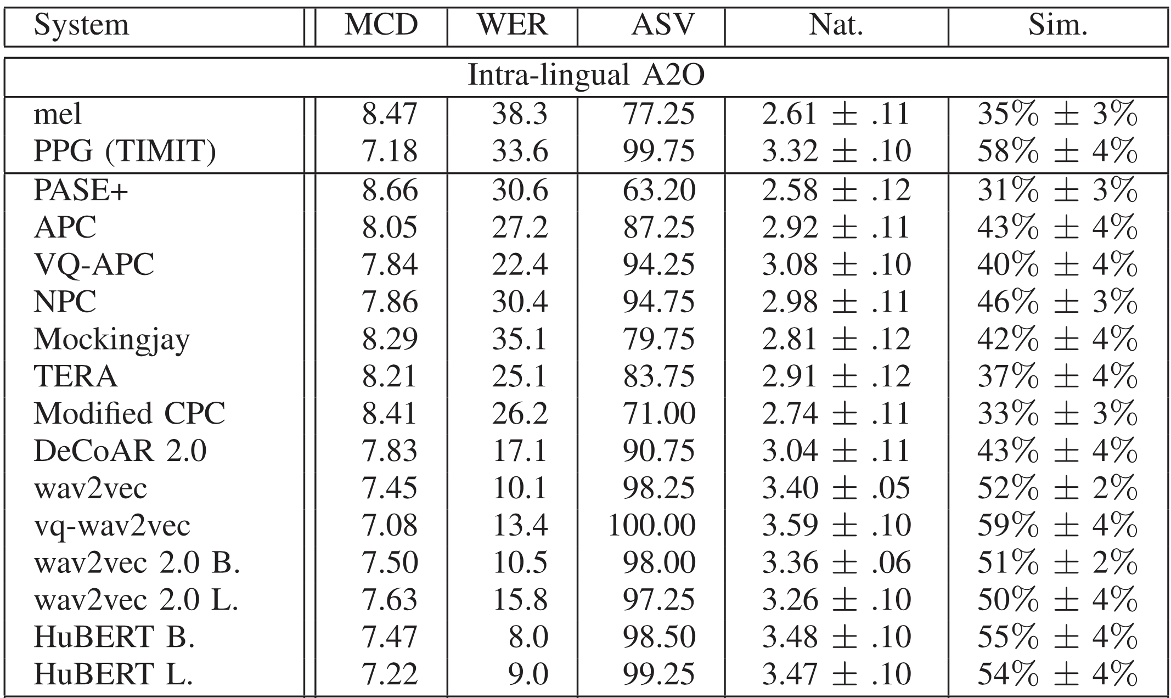
S3PRL-VC
How deep learning changed voice conversion: better content & speaker representations
[Huang+ ‘22]
Compare how different SSL features perform in VC

Slide 48
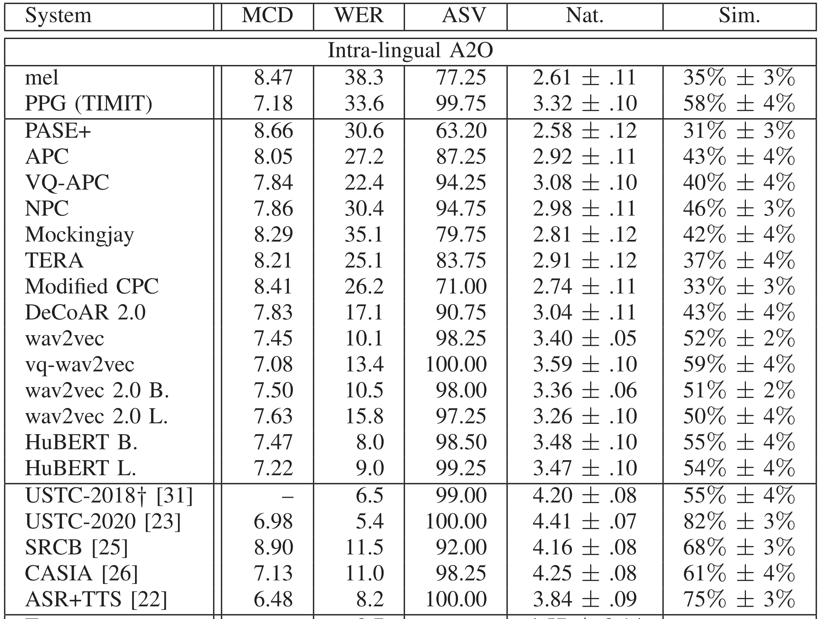
A comparison of different features
How deep learning changed voice conversion: better content & speaker representations
A comparison of content representations
 | Speech waveform | Spectrogram | SSL features | PPG (ASR encoder outputs) | Text
Resolution | 16000 Hz | 160~320 Hz | 160~320 Hz | 160~320 Hz | 1~2 Hz (1~2 words per second)
Speaker information | Complete | Complete | Much ~ few | Almost none | Almost none
SSL feature
PPG
text
PPG
PPG
text

Slide 49
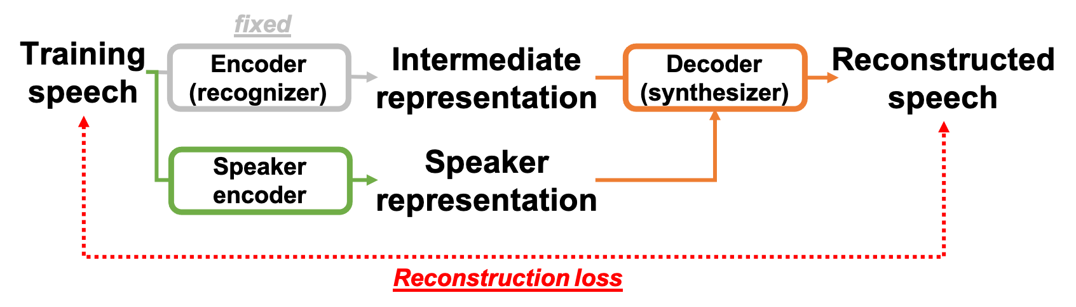
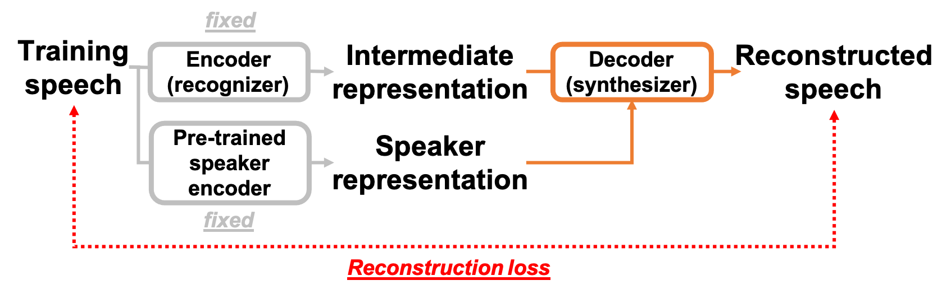
Two common practices for speaker representation in recognition-synthesis VC
How deep learning changed voice conversion: better content & speaker representations
Train a speaker encoder jointly with the synthesizer
Advantage: better conversion quality
Pre-trained speaker encoder (ex., d-vector, x-vector)
Advantage: better generalization ability
[Chien+ ‘21]
[Variani+ ‘14]
[Snyder+ ‘18]
This is still one of the most researched direction in VC

Slide 50
FAQ: Which one is better, parallel or nonparallel?
How deep learning changed voice conversion: better content & speaker representations
Quick answer: it all depends on the end-point application!
Is prosody modeling important in your application? (ex., accent conversion) (I assume parallel VC = use seq2seq) Is recording parallel data affordable in your application? (ex., speaking-aid) (patients would pay whatever it takes) ⇨ Parallel VC might be a better choice!
Otherwise, non-parallel VC!

Slide 51
Outline
2024/8/14 CITI Talk
Fundamentals of voice conversion
What is voice conversion? Why do we need it?
Early approaches to voice conversion
How deep learning changed voice conversion
Better modeling tools
Better content & speaker representations
Challenges remaining in voice conversion
Real-time, low-latency processing
Beyond “normal” voice conversion

Slide 52
Outline
2024/8/14 CITI Talk
Fundamentals of voice conversion
What is voice conversion? Why do we need it?
Early approaches to voice conversion
How deep learning changed voice conversion
Better modeling tools
Better content & speaker representations
Challenges remaining in voice conversion
Real-time, low-latency processing
Beyond “normal” voice conversion

Slide 53
Real-time and low-latency are different terms!
Challenges remaining in voice conversion: Real-time, low-latency processing
Note: in some signal processing fields they have the opposite definition...
Real-time factor (RTF)
The amount of time to process one second of speech
A system is considered real-time if RTF < 1
RTF is usually calculated given the whole input (i.e., batch processing)
In application like speaking-aid, this is an impractical setting
Latency
Time difference between input/output. Ex., latency=100ms means:
You here the converted speech 100 ms after you speak
The model can probably see < 100 ms of speech ahead

Slide 54
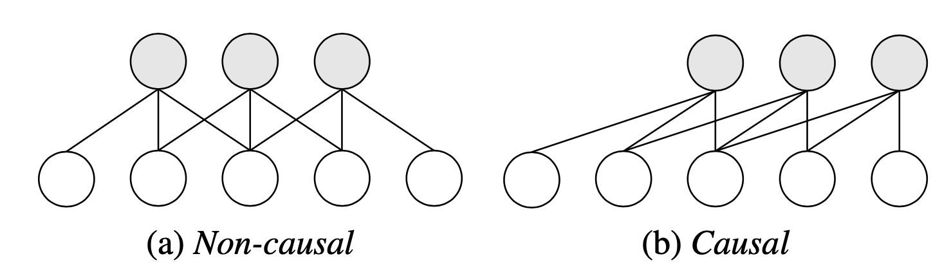
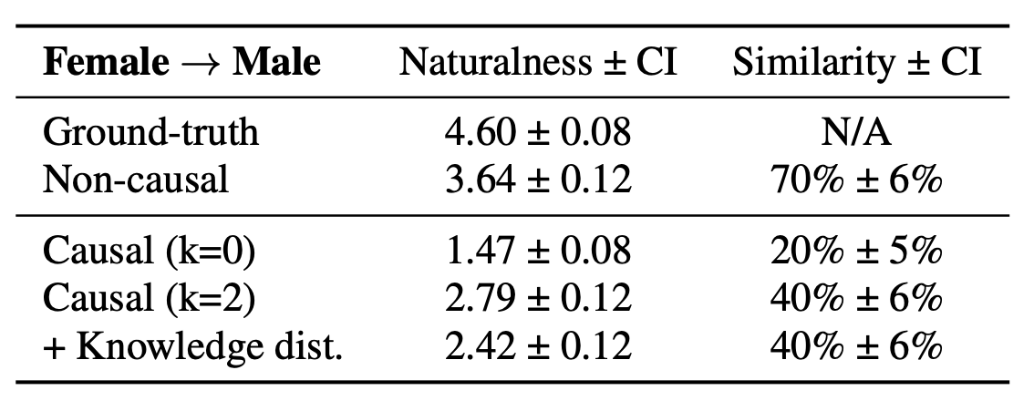
Inability to see the future hurts!
Challenges remaining in voice conversion: Real-time, low-latency processing
Ex., standard vs causal convolution
Lager the latency, the more future frames can be “peaked”
Large improvement if the model can “see the future”
[Hayashi+ ‘22]

Slide 55
Different applications can allow different
Challenges remaining in voice conversion: Real-time, low-latency processing
Hand-held devices have a more strict latency tolerance
Ex., speaking-aid, Detective Conan’s voice changer
Usually needs to be smaller than 100 ms
“Transmitted” services can allow for a larger latency
Ex., accent conversion in customer service centers, VTubers
It all depends on the edge application!

Slide 56
Outline
2024/8/14 CITI Talk
Fundamentals of voice conversion
What is voice conversion? Why do we need it?
Early approaches to voice conversion
How deep learning changed voice conversion
Better modeling tools
Better content & speaker representations
Challenges remaining in voice conversion
Real-time, low-latency processing
Beyond “normal” voice conversion

Slide 57

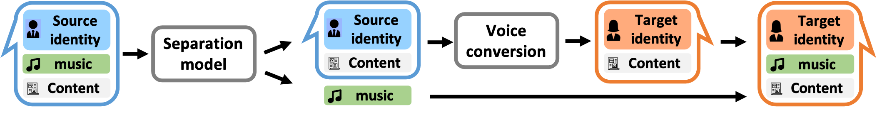
New application 1: VC in noisy environment
Challenges remaining in voice conversion: beyond “normal” voice conversion
Sometimes we want to do VC with noise (or music, etc.)
Back to the dubbing example…
Straightforward idea
https://yaoxunji.github.io/background_sound_vc/
[Yao+ ‘23]
Original
Converted
Difficulty: separation is hard!

Slide 58
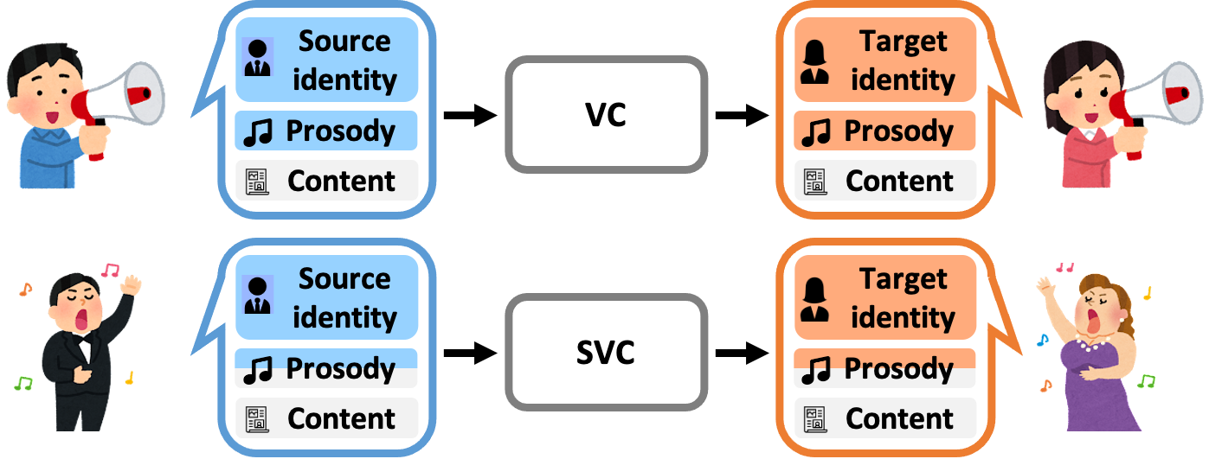
New application 2: Singing VC
Challenges remaining in voice conversion: beyond “normal” voice conversion
[Villavicencio+ ‘10]
What is the difference between normal VC and singing VC?
In singing VC, we want to change “singing style” but with same notes = add vibrato, falsetto, …, but sound like the same song

Slide 59
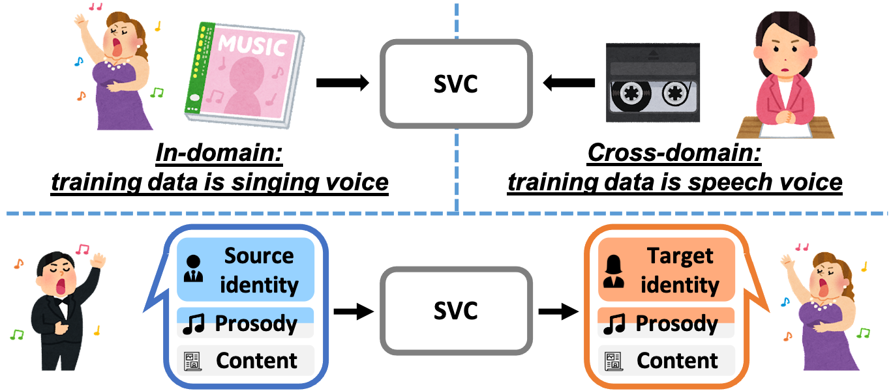
New application 2: Singing VC
Challenges remaining in voice conversion: beyond “normal” voice conversion
In-domain SVC vs cross-domain SVC
Is this … possible?

Slide 60
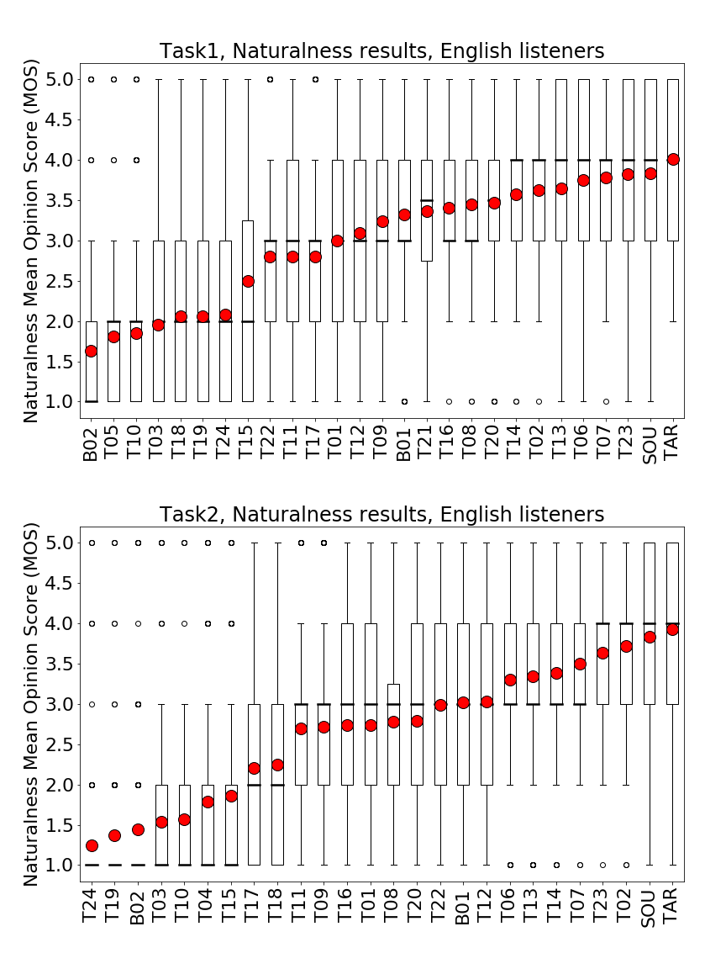
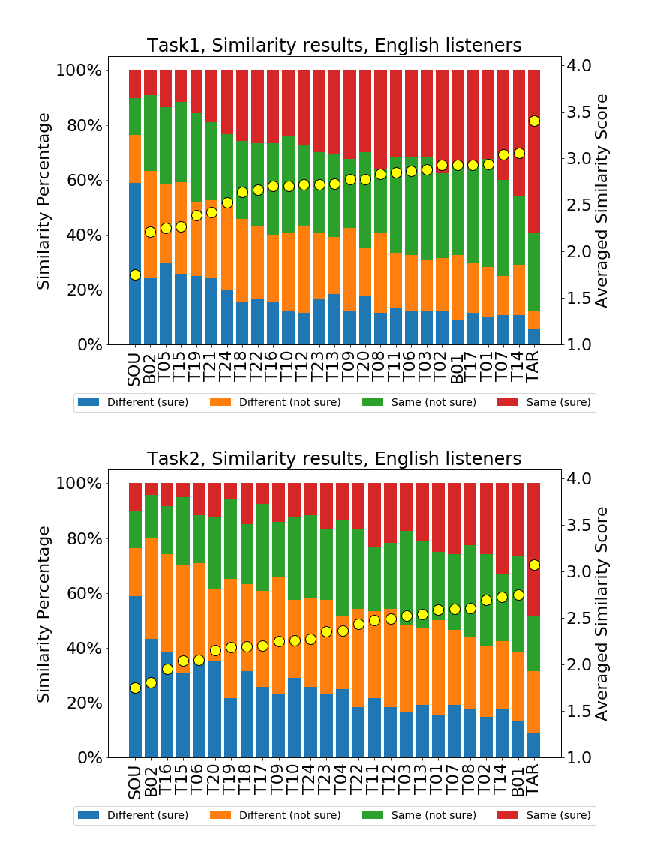
Singing voice conversion challenge (SVCC) 2023
Challenges remaining in voice conversion: beyond “normal” voice conversion
[Huang+ ‘23]
Two tasks:
In-domain SVC: training data is singing voice
Cross-domain SVC: training data is speech
Findings:
For naturalness, 3 teams were not significantly different from natural speech
For similarity, no teams were not significantly different from the target singers
Cross-domain SVC is harder than in-domain SVC

Slide 61

New application 3: accent conversion
Challenges remaining in voice conversion: beyond “normal” voice conversion
Convert from non-native speech → native speech
Also known as foreign accent conversion (FAC)
Convert from accent 1 → accent 2
Ex., American accent → British accent; 九州弁 → 関西弁
Difficulty: usually we want to main the speaker identity!
[Zhao+ ‘18] [Zhao+ ‘21]
[Ezzerg+ ‘23]

Slide 62
”Ground-truth free” VC
Challenges remaining in voice conversion: beyond “normal” voice conversion
There are many applications where the “ground-truth” speech is impossible to collect
Examples: accent conversion, pathological VC

Slide 63
Approaches to ground-truth free VC
Challenges remaining in voice conversion: beyond “normal” voice conversion
Take FAC as example. Ingredients: ”pseudo” parallel data
Straightforward approach: cascade
[Huang+ ‘21]

Slide 64
Approaches to ground-truth free VC
Challenges remaining in voice conversion: beyond “normal” voice conversion
Synthetic target generation (STG)
[Zhao+ ‘21]

Slide 65
Approaches to ground-truth free VC
Challenges remaining in voice conversion: beyond “normal” voice conversion
Latent space conversion (LSC)
[Quamer+ ‘22]

Slide 66
Approaches to ground-truth free VC
Challenges remaining in voice conversion: beyond “normal” voice conversion
Which one is the best? None of them!
[Huang+ ‘23]
Description | Objective | Subjective
手法 | Word error rate↓ | Naturalness ↑ | Source speaker similarity ↑ | Accentedness↓
Source nonnative speech | 12.3 | 4.18 ± 0.19 | N/A | 6.06 ± 0.38
Cascade | 52.7 | 3.50 ± 0.22 | 45.7% ± 7.3% | 4.18 ± 0.30
Synthetic target generation | 40.9 | 3.66 ± 0.20 | 57.3% ± 7.8% | 4.36 ± 0.32
Latent space conversion | 19.5 | 3.64 ± 0.22 | 43.8% ± 7.5% | 3.95 ± 0.31
Reference native speech | 4.3 | 4.42 ± 0.18 | N/A | 1.49 ± 0.21

Slide 67
Different VC application require different evaluation aspects
Challenges remaining in voice conversion: beyond “normal” voice conversion
Can you tell these two samples are from the same person?
Can you rate which sample has a heavier accent?
Can you rate which sample is closer to the reference?
The same singer can sound very differently in different parts of the same song
Even native speakers can have a hard time giving a judgement
Even in speaker conversion, It can be just… difficult

Slide 68
Outline
2024/8/14 CITI Talk
Fundamentals of voice conversion
What is voice conversion? Why do we need it?
Early approaches to voice conversion
How deep learning changed voice conversion
Better modeling tools
Better content & speaker representations
Challenges remaining in voice conversion
Real-time, low-latency processing
Beyond “normal” voice conversion

Slide 69
Concluding remarks
2024/8/14 CITI Talk
VC has many applications → it is considered an important and fundamental technique
Many people think VC is solved… is it?
Most papers use a very ideal experimental setting!
VC is useful only when used to improve people’s lives
Same for any AI technique!

Slide 70
Useful materials
2024/8/14 CITI Talk
Advanced Voice Conversion
https://www.slideshare.net/slideshow/advanced-voice-conversion/107923321#2
An Overview of Voice Conversion and its Challenges: From Statistical Modeling to Deep Learning
https://arxiv.org/abs/2008.03648

Slide 71
References (in chronological order)
2024/8/14 CITI Talk
[Abe+ ’90] Abe, Masanobu, et al. "Voice conversion through vector quantization." Journal of the Acoustical Society of Japan (E) 11.2 (1990): 71-76. [Stylianou+ ‘98] Stylianou, Yannis, Olivier Cappé, and Eric Moulines. "Continuous probabilistic transform for voice conversion." IEEE Transactions on speech and audio processing 6.2 (1998): 131-142. [Villavicencio+ ‘10] Villavicencio, Fernando, and Jordi Bonada. "Applying voice conversion to concatenative singing-voice synthesis." Interspeech. 2010. [Toda ‘14] T. Toda, "Augmented speech production based on real-time statistical voice conversion," 2014 IEEE Global Conference on Signal and Information Processing (GlobalSIP), Atlanta, GA, USA, 2014, pp. 592-596 [Goodfellow+ ‘14] Goodfellow, Ian, et al. "Generative adversarial nets." Advances in neural information processing systems 27 (2014). [Dinh+ ‘14] Dinh, Laurent, David Krueger, and Yoshua Bengio. "Nice: Non-linear independent components estimation." arXiv preprint arXiv:1410.8516 (2014). [Variani+ ‘14] Variani, Ehsan, et al. "Deep neural networks for small footprint text-dependent speaker verification." Proc. ICASSP 2014. [Sun+ ‘16] L. Sun, K. Li, H. Wang, S. Kang and H. Meng, "Phonetic posteriorgrams for many-to-one voice conversion without parallel data training," Proc. ICME, 2016, pp. 1-6. [van den Oord+ ‘16] Oord, Aaron van den, et al. "Wavenet: A generative model for raw audio." arXiv preprint arXiv:1609.03499 (2016). [Hsu+ ‘17] Hsu, C.-C., Hwang, H.-T., Wu, Y.-C., Tsao, Y., Wang, H.-M. (2017) Voice Conversion from Unaligned Corpora Using Variational Autoencoding Wasserstein Generative Adversarial Networks. Proc. Interspeech 2017, 3364-3368 [Chou+ ‘18] Chou, J.-c., Yeh, C.-c., Lee, H.-y., Lee, L.-s. (2018) Multi-target Voice Conversion without Parallel Data by Adversarially Learning Disentangled Audio Representations. Proc. Interspeech 2018, 501-505 [Kaneko+ ‘18] Kaneko, Takuhiro, and Hirokazu Kameoka. "Cyclegan-vc: Non-parallel voice conversion using cycle-consistent adversarial networks." Proc. EUSIPCO, 2018. [Snyder+ ‘18] Snyder, David, et al. "X-vectors: Robust dnn embeddings for speaker recognition." Proc. ICASSP 2018 [Zhao+ ‘18] Zhao, Guanlong, et al. "Accent conversion using phonetic posteriorgrams." Proc. ICASSP, 2018

Slide 72
References (in chronological order)
2024/8/14 CITI Talk
[Wagner+ ‘19] Wagner, P., Beskow, J., Betz, S., Edlund, J., Gustafson, J., Eje Henter, G., Le Maguer, S., Malisz, Z., Székely, É., Tånnander, C., Voße, J. (2019) Speech Synthesis Evaluation — State-of-the-Art Assessment and Suggestion for a Novel Research Program. Proc. 10th ISCA Workshop on Speech Synthesis (SSW 10), 105-110 [Prenger+ ‘19] R. Prenger, R. Valle and B. Catanzaro, "Waveglow: A Flow-based Generative Network for Speech Synthesis," Proc. ICASSP 2019, pp. 3617-3621 [Tanaka+ ‘19] K. Tanaka, H. Kameoka, T. Kaneko and N. Hojo, "ATTS2S-VC: Sequence-to-sequence Voice Conversion with Attention and Context Preservation Mechanisms," Proc. ICASSP, 2019, pp. 6805-6809 [Huang+ ‘20] W.-C., Hayashi, T., Wu, Y.-C., Kameoka, H., Toda, T. (2020) Voice Transformer Network: Sequence-to-Sequence Voice Conversion Using Transformer with Text-to-Speech Pretraining. Proc. Interspeech 2020, 4676-4680 [Zhao+ ‘20] Z. Yi, W.-C. Huang, X. Tian, J. Yamagishi, R.K. Das, T. Kinnunen, Z. Ling, T. Toda, "Voice Conversion Challenge 2020 -- intra-lingual semi-parallel and cross-lingual voice conversion --" Proc. Joint workshop for the Blizzard Challenge and Voice Conversion Challenge 2020, pp. 80-98, Oct. 2020. [Ho+ ‘20] Ho, Jonathan, Ajay Jain, and Pieter Abbeel. "Denoising diffusion probabilistic models." Advances in neural information processing systems 33 (2020): 6840-6851. [Baevski+ ‘21] Baevski, Alexei, et al. "wav2vec 2.0: A framework for self-supervised learning of speech representations." Advances in neural information processing systems 33 (2020): 12449-12460. [Hsu+ ‘21] W. -N. Hsu, Y. -H. H. Tsai, B. Bolte, R. Salakhutdinov and A. Mohamed, "Hubert: How Much Can a Bad Teacher Benefit ASR Pre-Training?," Proc. ICASSP, 2021, pp. 6533-6537. [Liu+ ‘21] Liu, Songxiang, et al. "Any-to-many voice conversion with location-relative sequence-to-sequence modeling." IEEE/ACM Transactions on Audio, Speech, and Language Processing 29 (2021): 1717-1728. [Bai+ ‘21] Bai, Ye, et al. "Integrating knowledge into end-to-end speech recognition from external text-only data." IEEE/ACM Transactions on Audio, Speech, and Language Processing 29 (2021): 1340-1351.

Slide 73
References (in chronological order)
2024/8/14 CITI Talk
[Kong+ ‘21] Jaehyeon Kim, Jungil Kong, Juhee Son, “Conditional Variational Autoencoder with Adversarial Learning for End-to-End Text-to-Speech,” Proc. ICML, 2021, 5530-5540. [Yang+ ‘21] Song, Yang, et al. "Score-based generative modeling through stochastic differential equations." Proc. ICLR; 2021 [Chien+ ‘21] C. -M. Chien, J. -H. Lin, C. -y. Huang, P. -c. Hsu and H. -y. Lee, "Investigating on Incorporating Pretrained and Learnable Speaker Representations for Multi-Speaker Multi-Style Text-to-Speech," Proc. ICASSP 2021, pp. 8588-8592 [Zhao+ ‘21] G. Zhao, S. Ding and R. Gutierrez-Osuna, "Converting Foreign Accent Speech Without a Reference," in IEEE/ACM TASLP, vol. 29, pp. 2367-2381, 2021 [Huang+ ‘22] Huang, Wen-Chin, et al. "A comparative study of self-supervised speech representation based voice conversion." IEEE Journal of Selected Topics in Signal Processing 16.6 (2022): 1308-1318. [Gan+ ‘22] Gan, Wendong, et al. "Iqdubbing: Prosody modeling based on discrete self-supervised speech representation for expressive voice conversion." arXiv preprint arXiv:2201.00269 (2022). [Chen+ ‘22] S. Chen et al., "WavLM: Large-Scale Self-Supervised Pre-Training for Full Stack Speech Processing," in IEEE Journal of Selected Topics in Signal Processing, vol. 16, no. 6, pp. 1505-1518, Oct. 2022. [Liu+ ‘22] Liu, Jinglin, et al. "Diffsinger: Singing voice synthesis via shallow diffusion mechanism." Proc. AAAI, Vol. 36. No. 10. 2022. [Radford+ ‘23] Radford, Alec, et al. "Robust speech recognition via large-scale weak supervision." International conference on machine learning. PMLR, 2023. [Yao+ ‘23] Yao, Jixun, et al. "Preserving background sound in noise-robust voice conversion via multi-task learning." Proc. ICASSP, 2023. [Huang+ ‘23] Huang, Wen-Chin, et al. "The singing voice conversion challenge 2023." Proc. Automatic Speech Recognition and Understanding Workshop (ASRU). 2023. [Ezzerg+ ‘23] Ezzerg, Abdelhamid, et al. "Remap, warp and attend: Non-parallel many-to-many accent conversion with normalizing flows." Proc. IEEE Spoken Language Technology Workshop (SLT). 2023. [Ju+ ‘24] Ju, Zeqian, et al. "Naturalspeech 3: Zero-shot speech synthesis with factorized codec and diffusion models." arXiv preprint arXiv:2403.03100 (2024).

